Slide 1

Wiley Edge Final Project
GROUP 1
Abdullah Tariq
Giovanni De Franceschi
Riyad Argoub
Shop orders management tool
Full Stack Application

Slide 2

BUSINESS MODEL
Create an order management system to be used by small business owners to visualize and manage various custom orders coming in
Have a login page so each user’s order inventory will only be visible to them
Implement a geographical representation of the clients’ positions in order to picture the dispersion of orders across the globe

Slide 3


The Project: Shopping Management tool
Create a frontend application in Angular with interface for:
Displaying all the orders of a business owner
Display orders details
Create a backend application in JAVA JPA to request http services and execute CRUD actions on the database
SQL Database MySQL
Spring JPA
Google Maps API and OpenWeatherMap API to visualize the buyer’s geographical position

Slide 4


DATABASE
Define business logic
Define entities
Define relationships
Normalization of databases

Slide 5
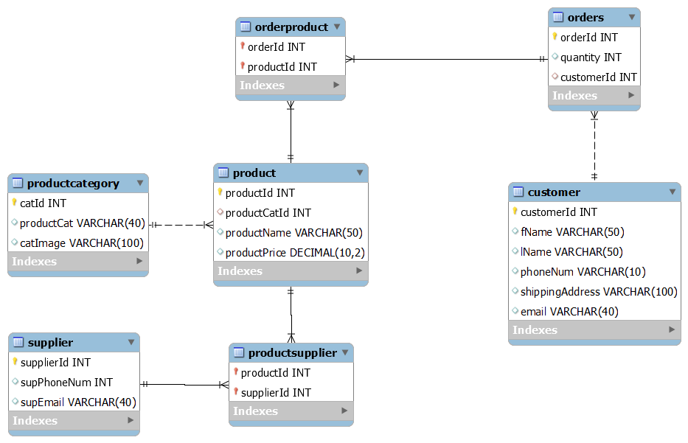
DATABASE ERD

Slide 6
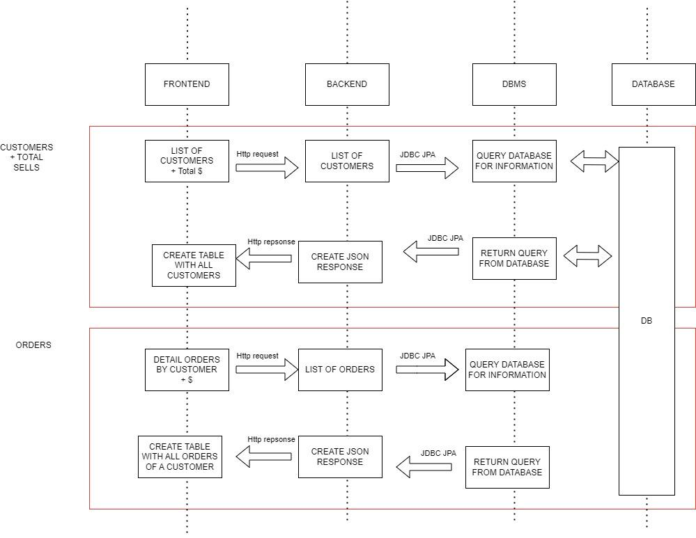
FLOWCHART

Slide 7

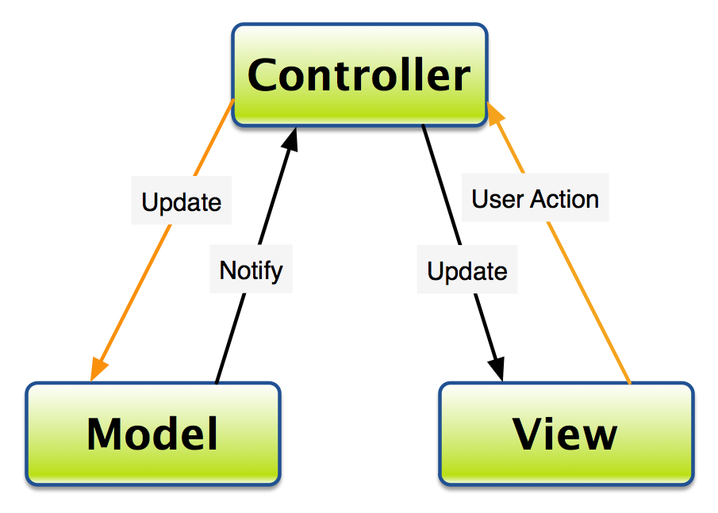
JAVA Spring JPA App
MVC Model structure
Model
Control
View
(data + business logic)
(orchestrate)
(user interface
+ displaying the data from the model)
Spring JPA Annotations

Slide 8

JAVA Spring JPA App
CRUD OPERATIONS
@GetMapping
@PostMapping
@PutMapping
@DeleteMapping
@PathVariable
@RequestBody
@RequestBody
@PathVariable

Slide 9

JAVA Spring JPA Exceptions handling
NotAvailableError.java
OrderNotFoundException.java
OrderIdDuplicateException.java
OrderDataValidationException.java

Slide 10


JAVA Unit test with JUnit suite
STATEFUL UNIT TEST
Service layer
Controller

Slide 11


Using the Geographical APIs
-OpenWeatherMap API
-Google Maps API

Slide 12

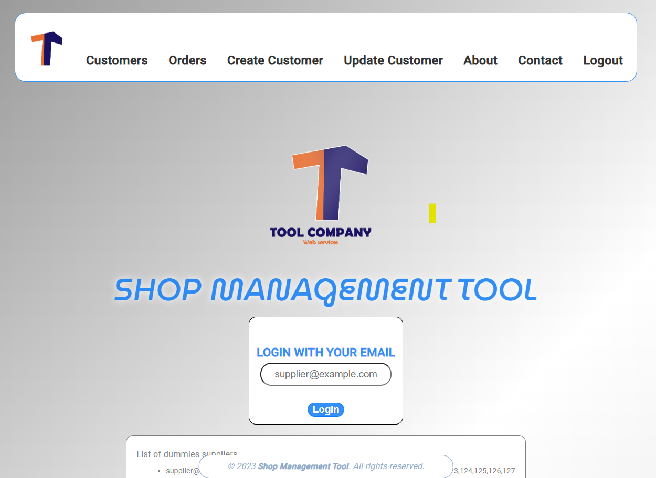
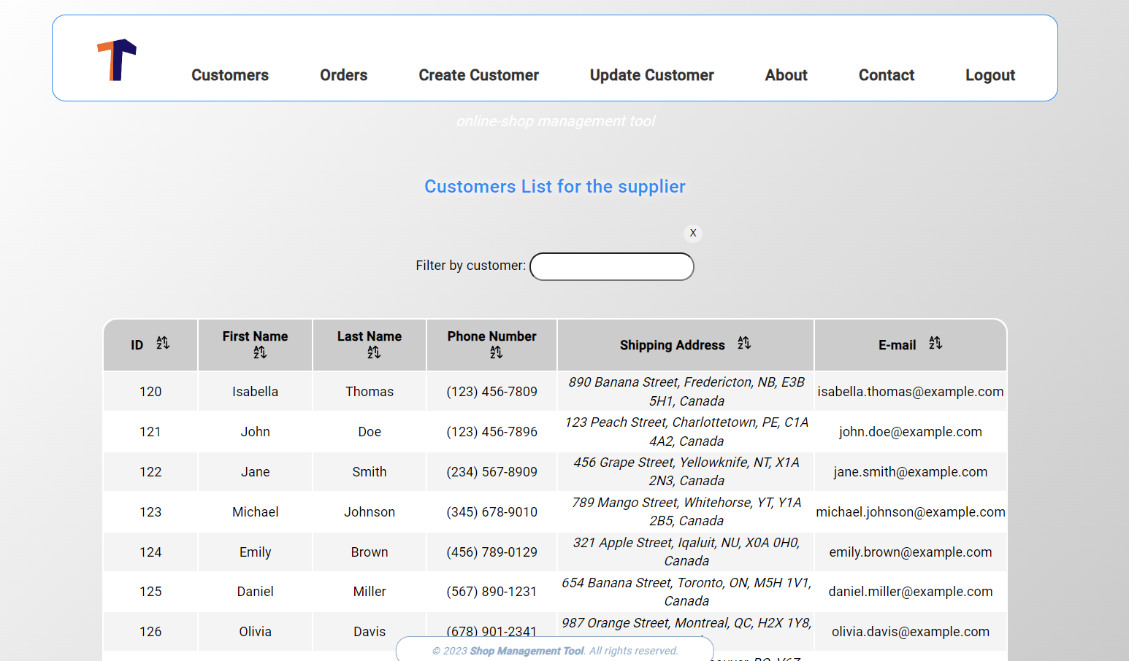
FRONTED UI - Angular TS
LOGIN
LIST OF CUSTOMERS

Slide 13
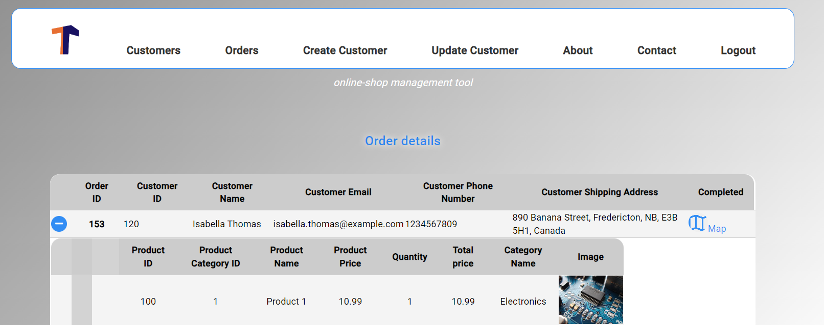
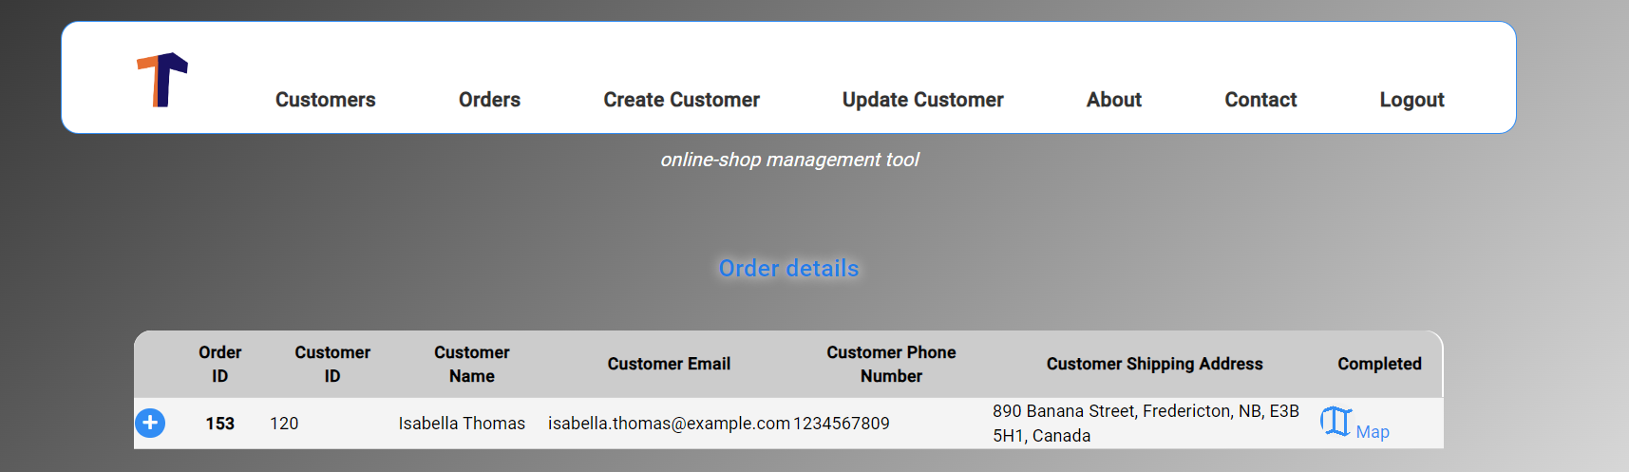
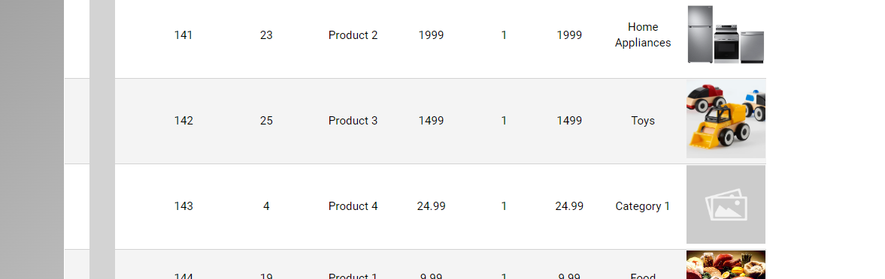
FRONTED UI - Angular
LIST OF CUSTOMERS

Slide 14
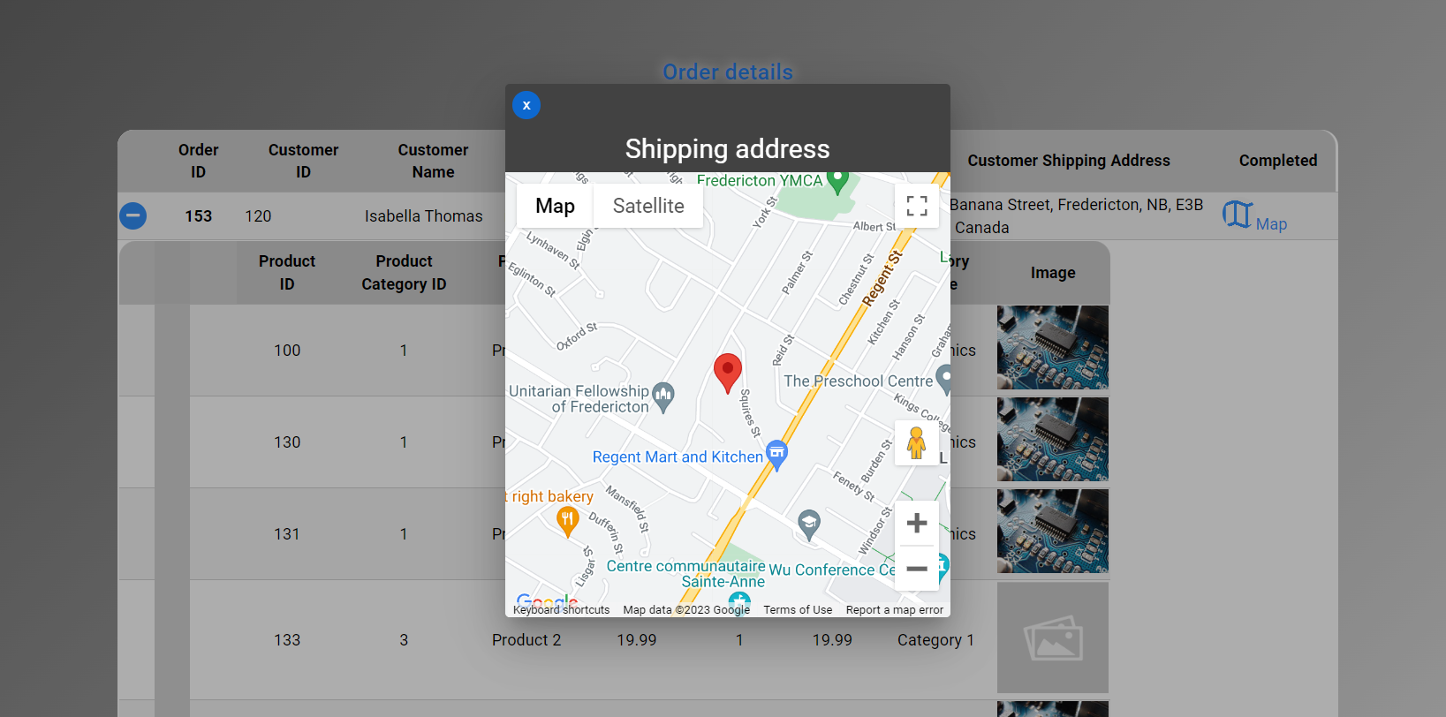
FRONTED UI - Angular
GEOLOCALIZATION

Slide 15
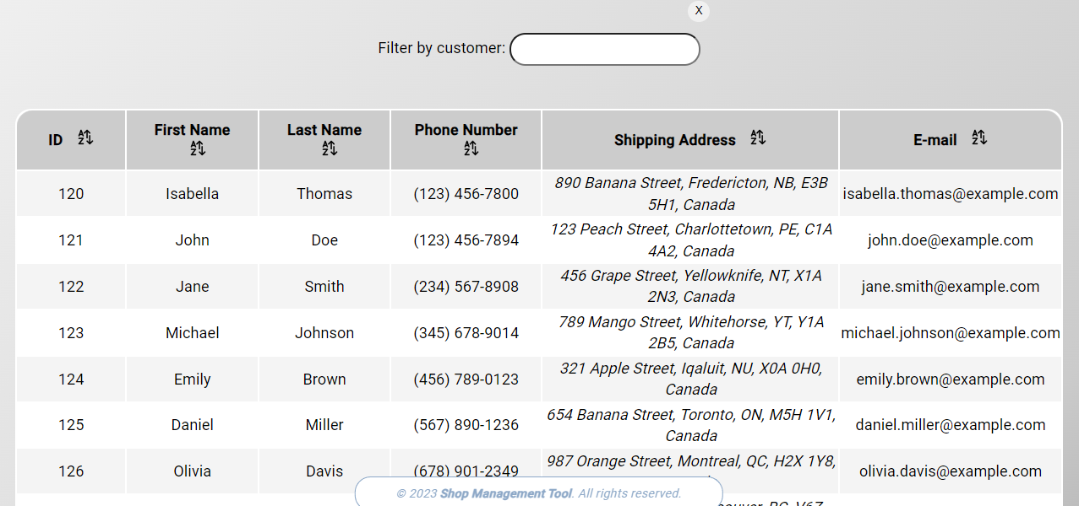
FRONTED UI - Angular
VISUALIZATION
Filtering service
Sorting service
Phone formatting Pipe
Capitalization Pipe

Slide 16
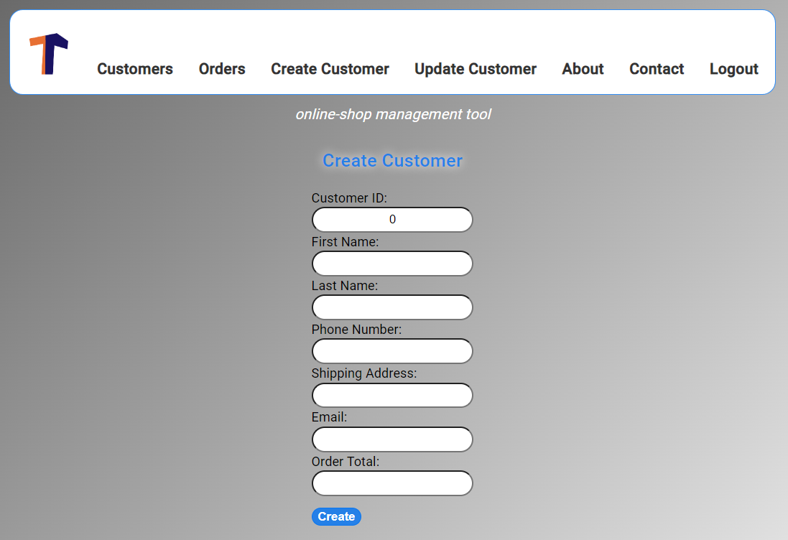
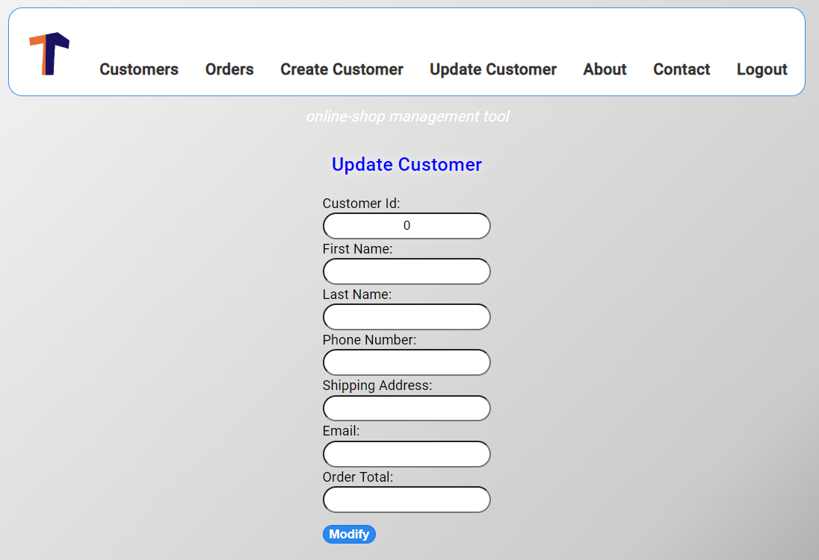
FRONTED UI - Angular
CRUD OPERATIONS FROM WEB INTERFACE
Create, Update UI
Endpoints for others
operation

Slide 17
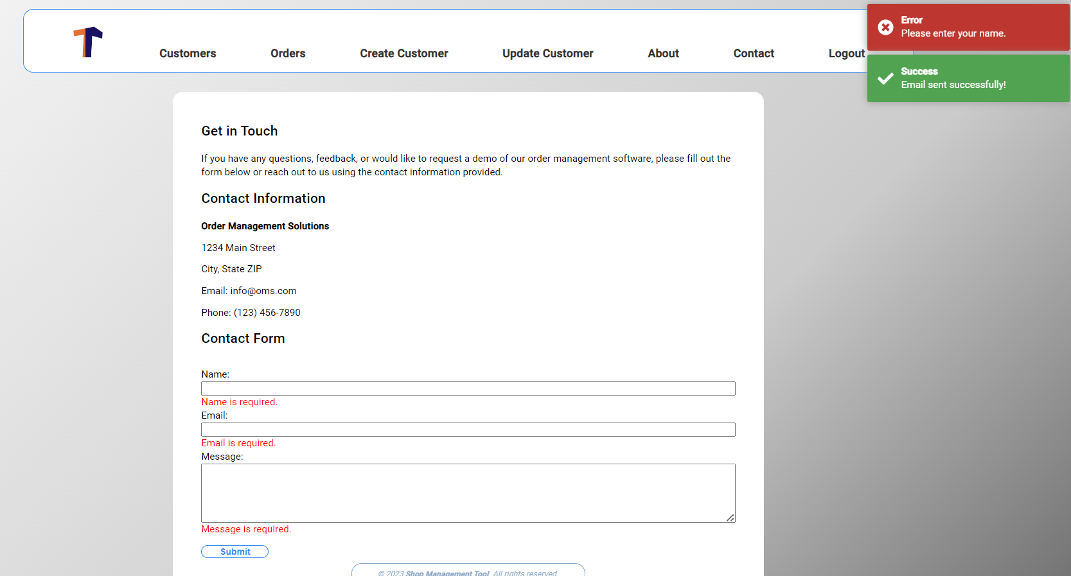
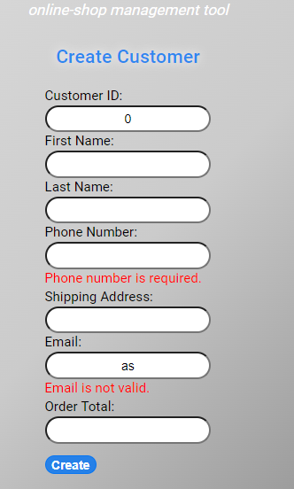
FRONTED UI - Angular
FIELDS VALIDATION
Fields validation
Popup feedback messages

Slide 18
Lessons Learned
Utilizing an API can be very efficient for the end-user, but it can become very costly for a developer if not tested correctly. APIs can be essential to a business.

Slide 19
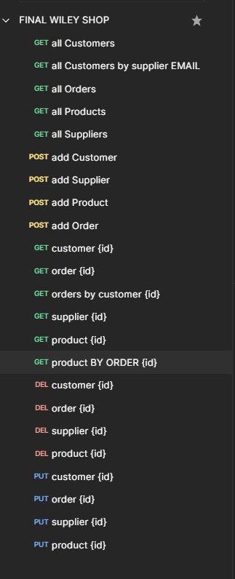
Possible improvements
Provide web interface for all
the endpoints created in the backend
Include user profile with picture
Implement payment database
Storing different sessions for different users made us use our SQL abilities in order to correctly attribute each orders/customers to the correct user.

Slide 20
THANKS
GROUP 1
Abdullah Tariq
Giovanni De Franceschi
Riyad Argoub

